Slide 1
Bayesian Analysis of Dynamic Occupancy Model for Crossbill
李世祺12211031 倪昊辰12213027 黄宇航12213015

Slide 2
Catalogue
Background & Objective
Data Description
Model Specification
Bayesian Implementation——MCMC
Bayesian Implementation with Covariates
Diagnostics & Model Evaluation

Slide 3

Background
Crossbill（交嘴雀）：gets name from the crossing of the upper and lower bill when closed. Living in cold temperate zone with thick pine forests at a medium altitude.
DYNAMIC OCCUPANCY MODELS（动态占用模型）：Dynamic occupancy models explicitly represent colonization and extinction processes.

Slide 4
Data
Dimension：267 observation locations，9 years(from 1999 to 2007)，each years with 3 times survey
Structure：classification data, 1 for detection, 0 for non-detection
Quadrat：267 1-kmsq lands
Key parameters：initial occupancy probability，growth rate，local colonization，detection probability
Others：elevation and percent forest cover of observation points,
day of season: survey date from the breeding season(Apr.15-Jul.15)

Slide 5
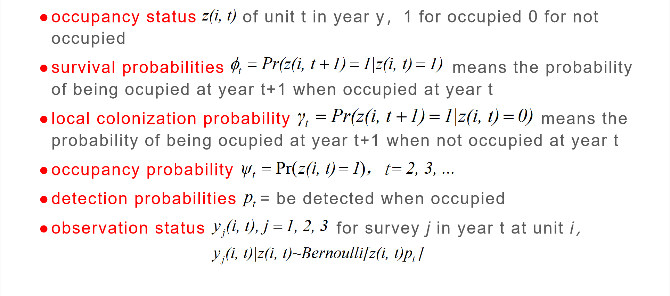
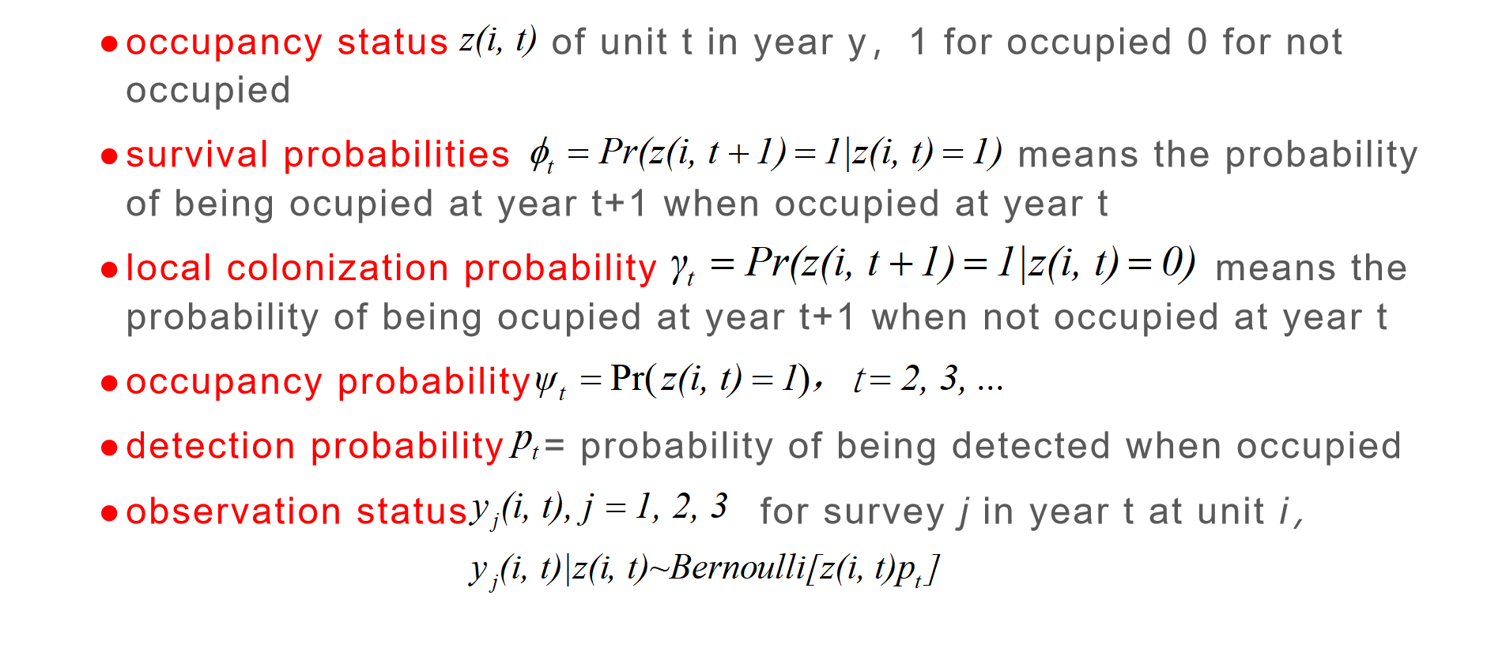
Model Parameters
occupancy status of unit t in year y，1 for occupied 0 for not occupied
survival probabilities means the probability of being ocupied at year t+1 when occupied at year t
local colonization probability means the probability of being ocupied at year t+1 when not occupied at year t
occupancy probability
observation status for survey j in year t at unit i，

Slide 6
Model Parameters
occupancy status of unit t in year y，1 for occupied 0 for not occupied
survival probabilities means the probability of being ocupied at year t+1 when occupied at year t
local colonization probability means the probability of being ocupied at year t+1 when not occupied at year t
occupancy probability
detection probability = probability of being detected when occupied
observation status for survey j in year t at unit i，

Slide 7
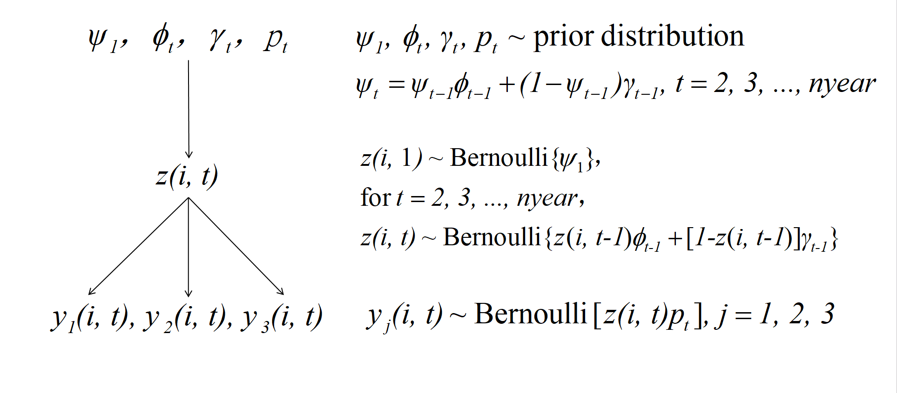
Hierarchical Model

Slide 8
Hierarchical Model

Slide 9
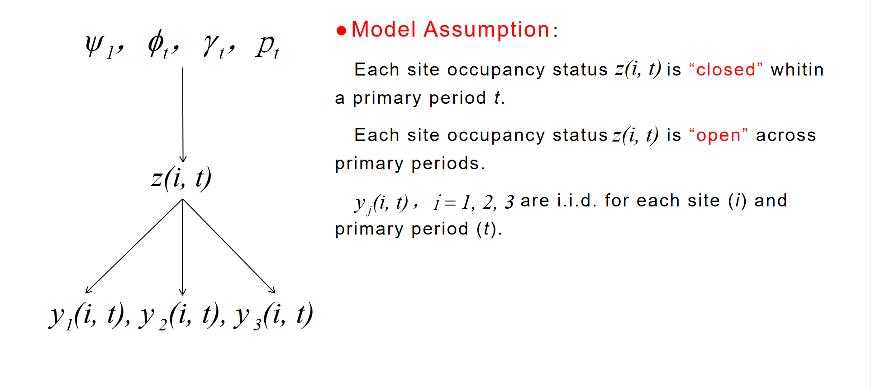
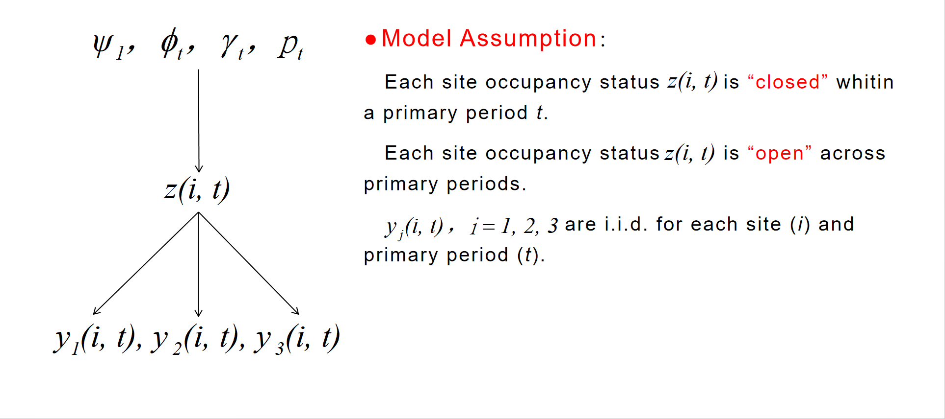
Hierarchical Model
Model Assumption：
Each site occupancy status is “closed” whitin a primary period t.
Each site occupancy status is “open” across primary periods.
are i.i.d. for each site (i) and primary period (t).

Slide 10
Hierarchical Model
Model Assumption：
Each site occupancy status is “closed” whitin a primary period t.
Each site occupancy status is “open” across primary periods.
are i.i.d. for each site (i) and primary period (t).

Slide 11
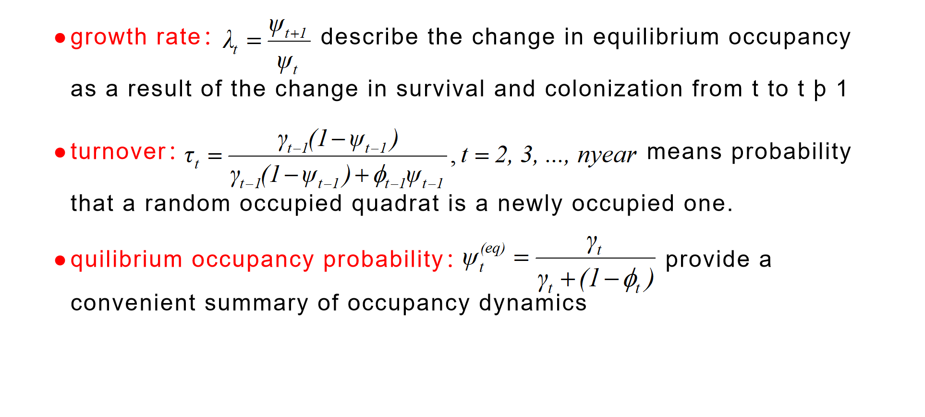
Metapopulation Quantities
growth rate： describe the change in equilibrium occupancy as a result of the change in survival and colonization from t to t þ 1
turnover： means probability that a random occupied quadrat is a newly occupied one.
quilibrium occupancy probability： provide a convenient summary of occupancy dynamics

Slide 12
Metapopulation Quantities
growth rate： describe the change in equilibrium occupancy as a result of the change in survival and colonization from t to t þ 1
turnover： means probability that a random occupied quadrat is a newly occupied one.
quilibrium occupancy probability： provide a convenient summary of occupancy dynamics

Slide 13
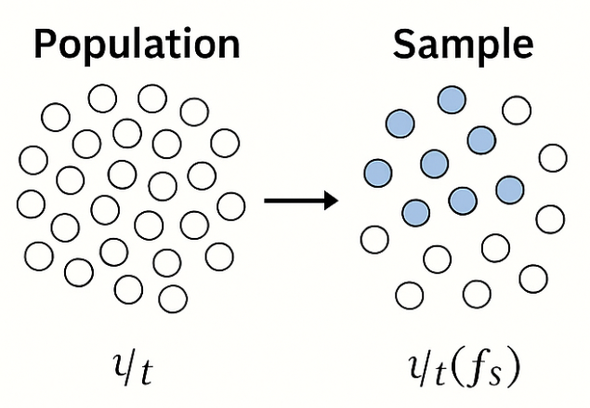
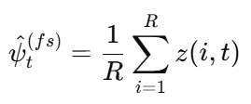
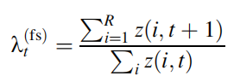
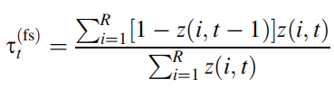
Finite Sample Estimation
Definition: estimate quantities for the actual sampled sites, rather than for an idealized, infinite population
Advantage: ①More precise for the current sample ②Directly answers questions about "this dataset"
Finite-sample estimate Sample growth rate estimate Sample turnover rate

Slide 14
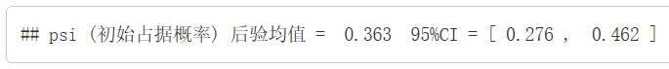
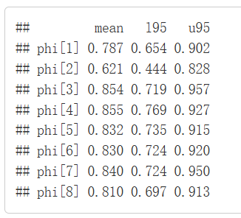
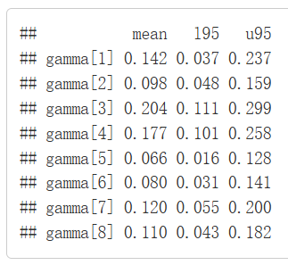
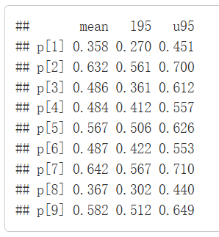
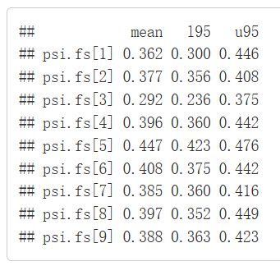
MCMC——JAGS
with Prior distribution:

Slide 15
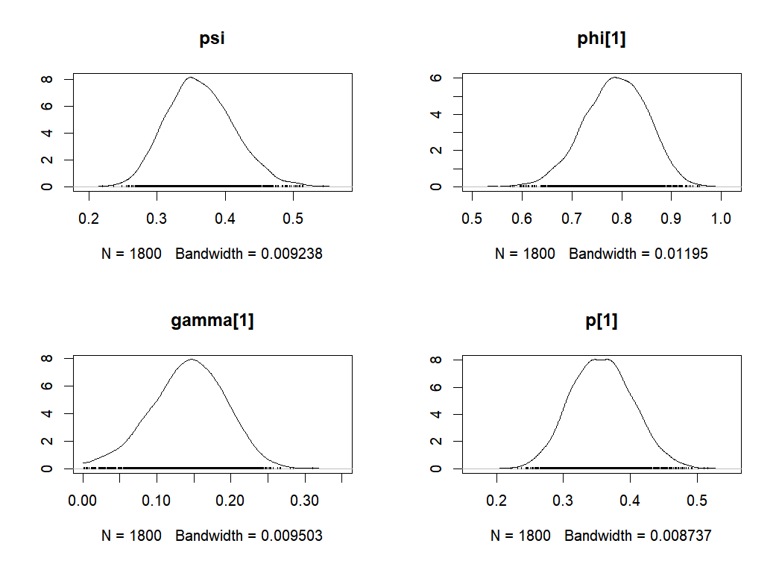
MCMC——JAGS
Notes:
近似正态分布

Slide 16
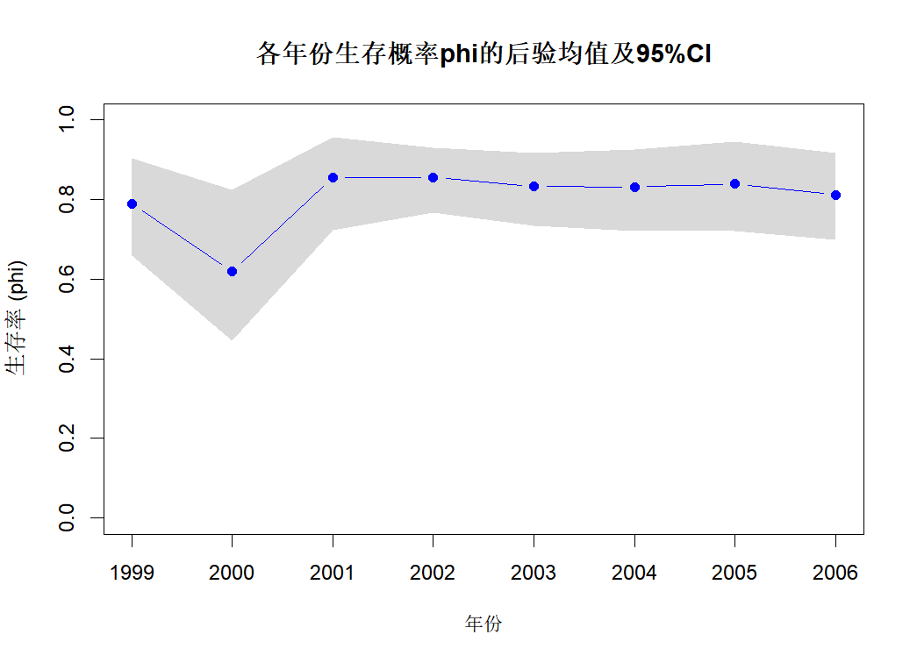
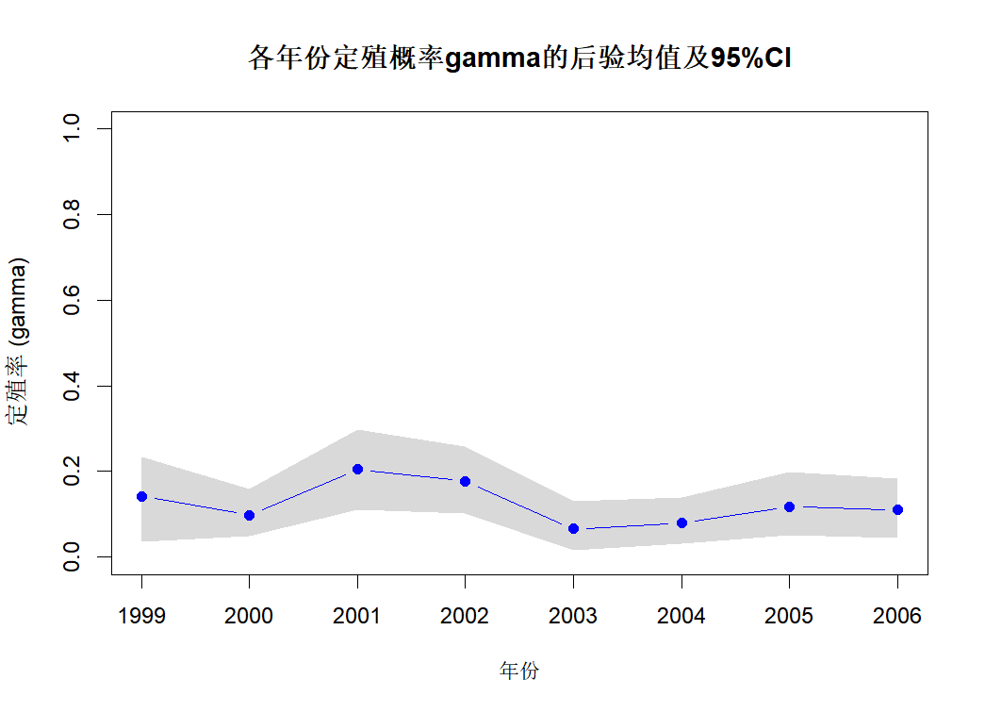
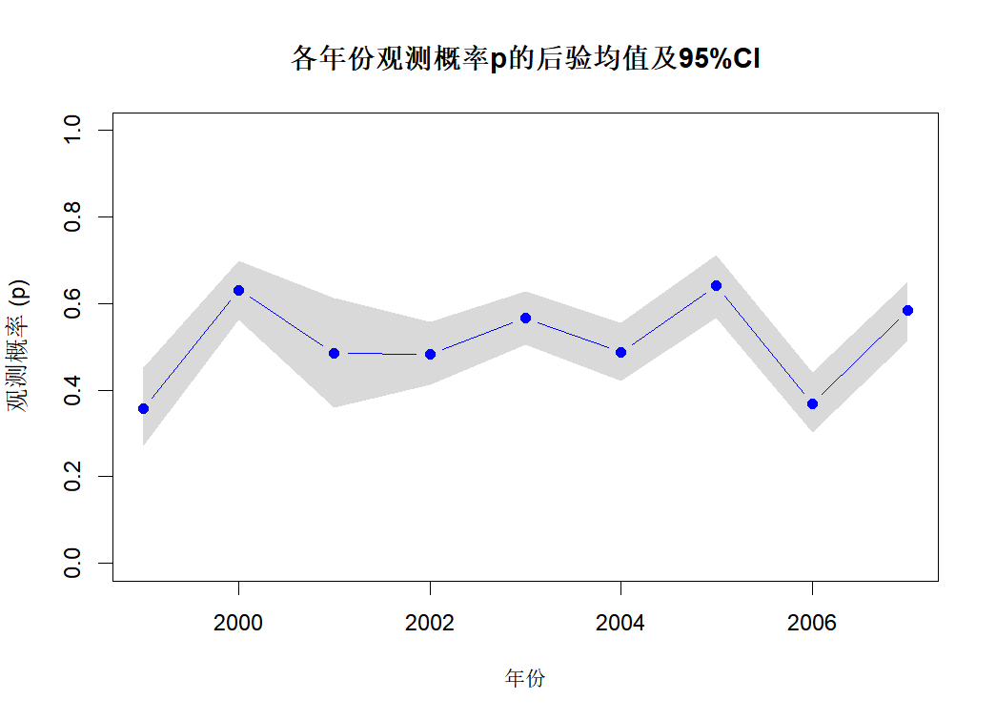
MCMC——JAGS

Slide 17
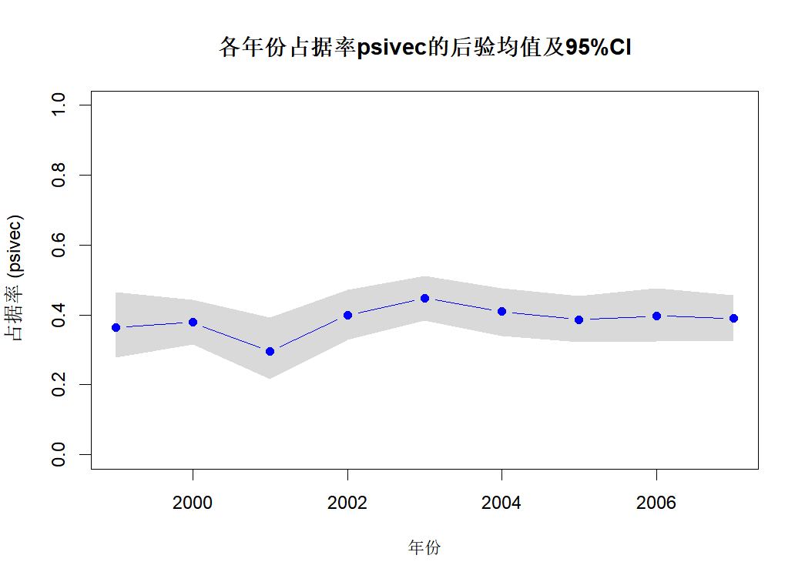
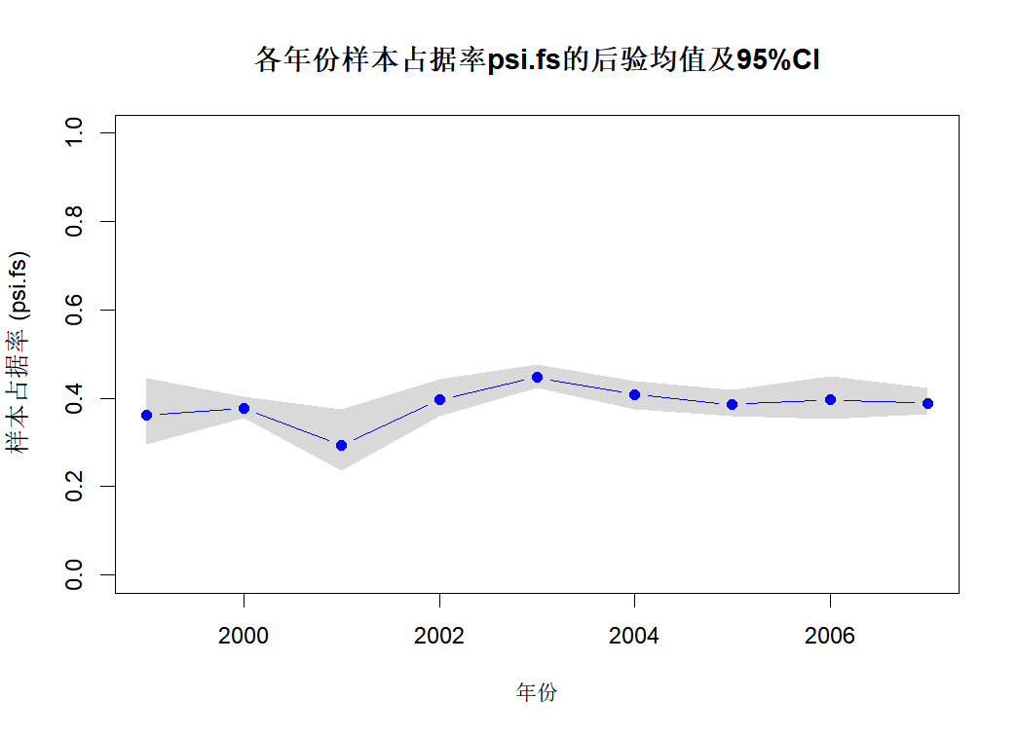
MCMC——JAGS

Slide 18
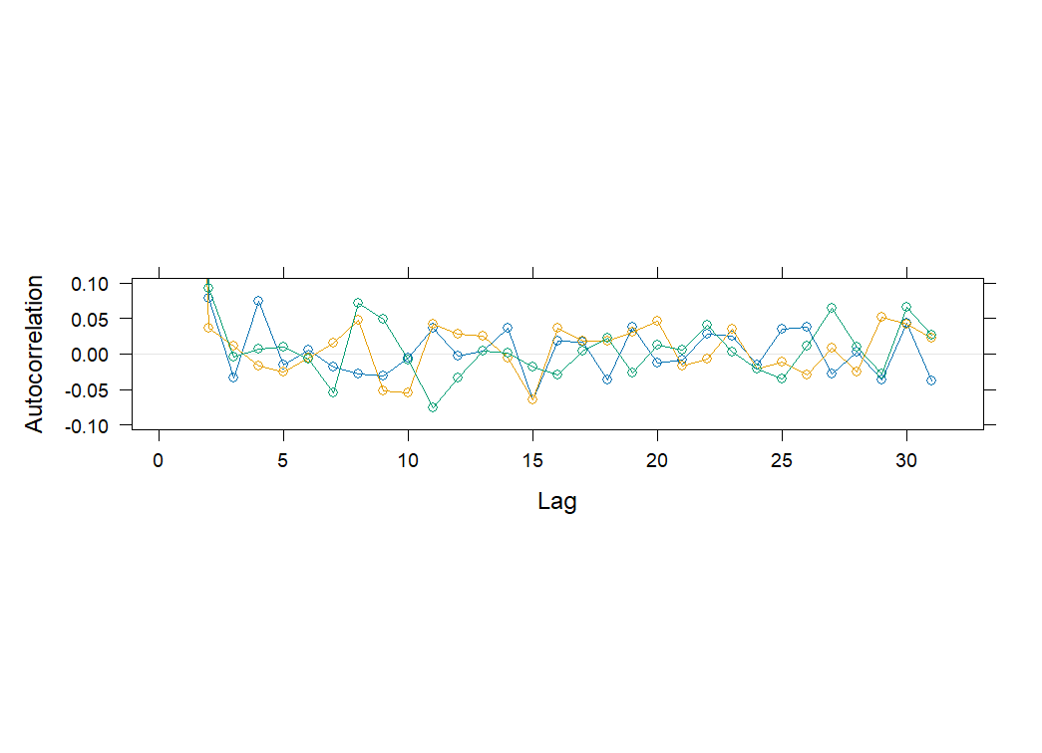
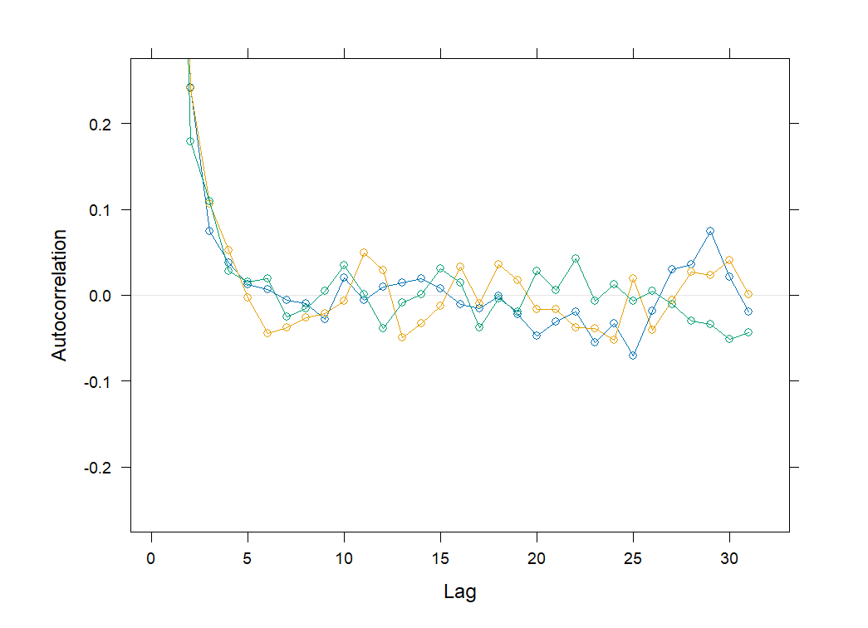
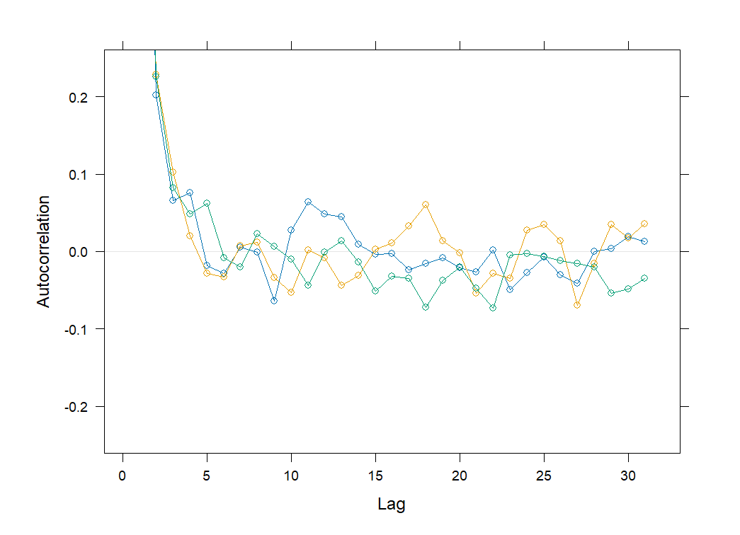
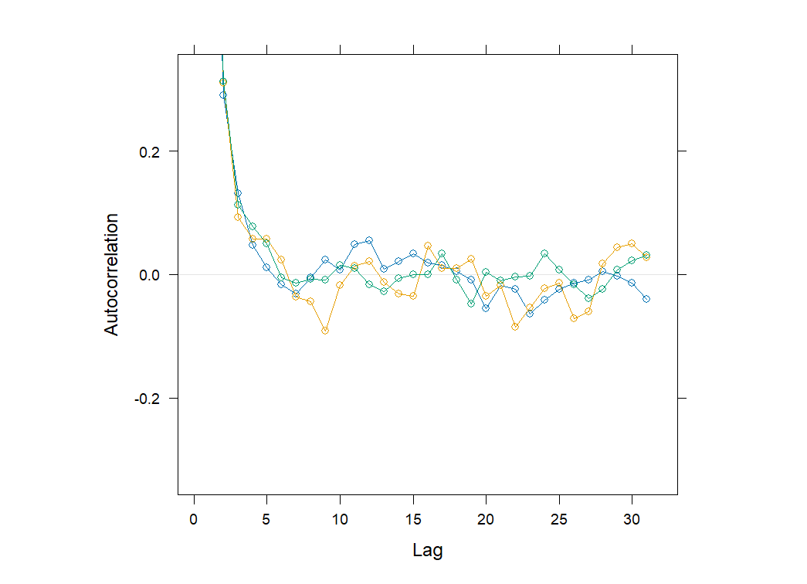
ACF plot
chains start at: 0.2 0.5 0.8 respectively
psi:
phi[1]:
p[1]:
gamma[1]:
Notes:
7min21s

Slide 19
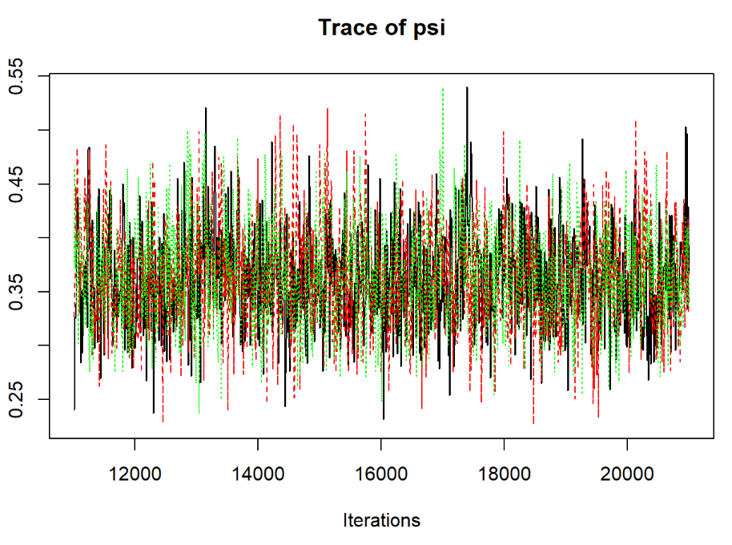
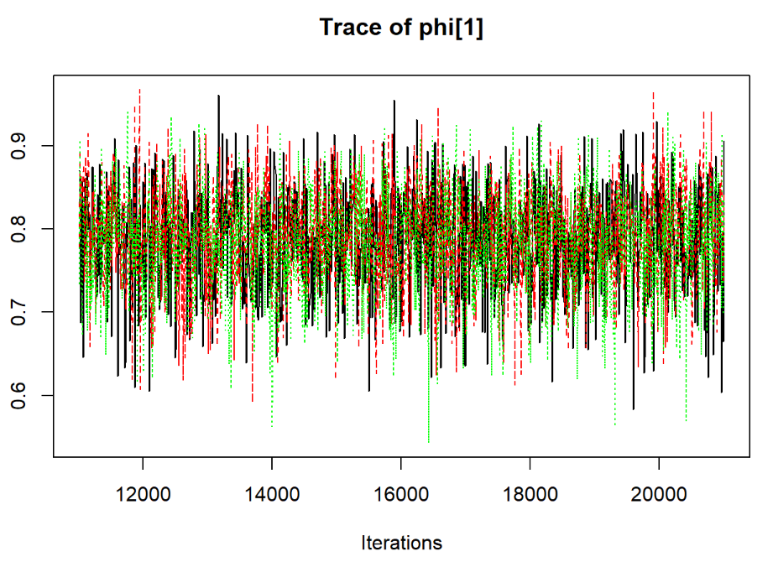
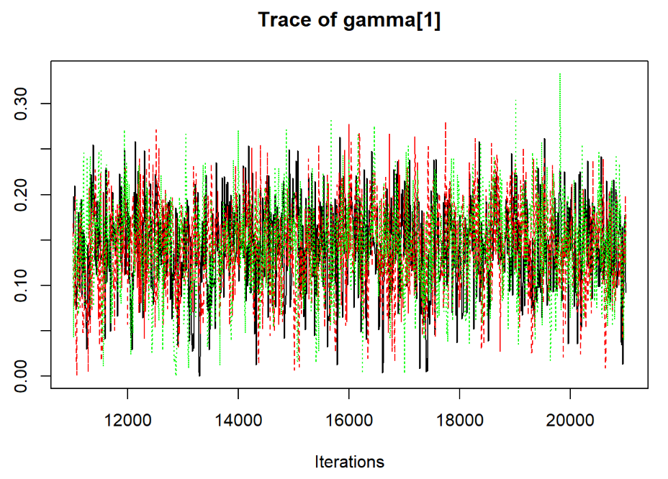
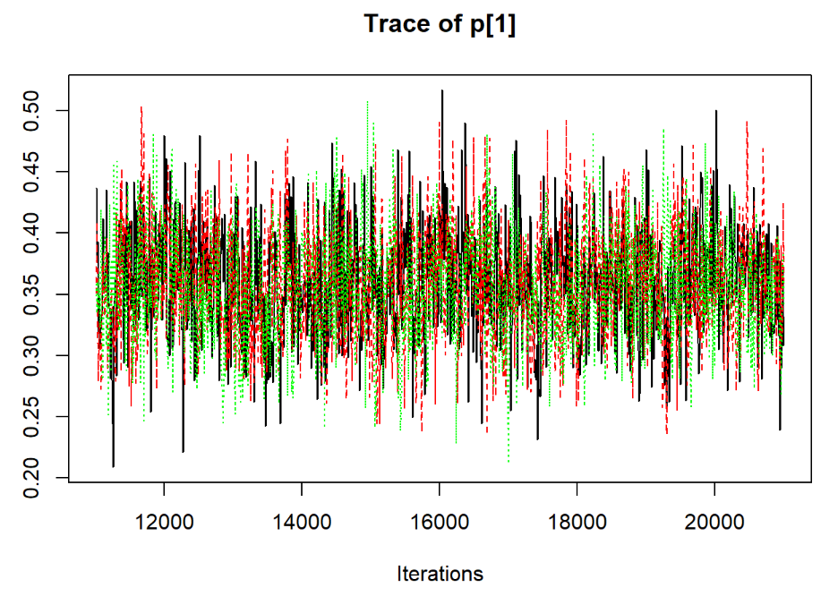
TracePlot
chains start at: 0.2 0.5 0.8 respectively

Slide 20
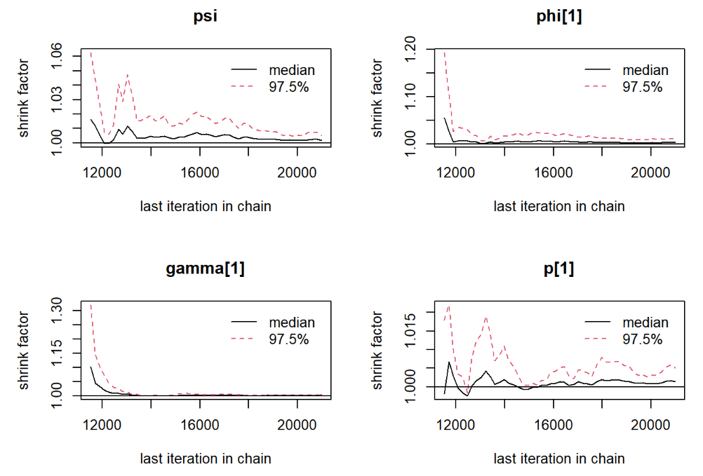
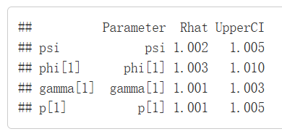
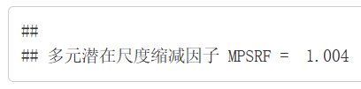
Gelman-Rubin
Notes:
7min21s

Slide 21

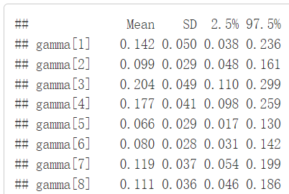


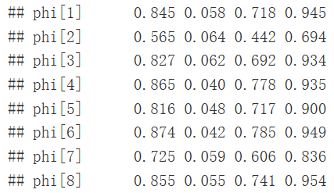
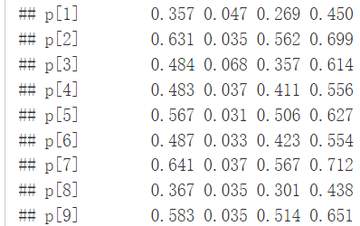
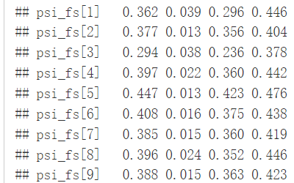
MCMC——NIMBLE
Notes:
6min43s

Slide 22
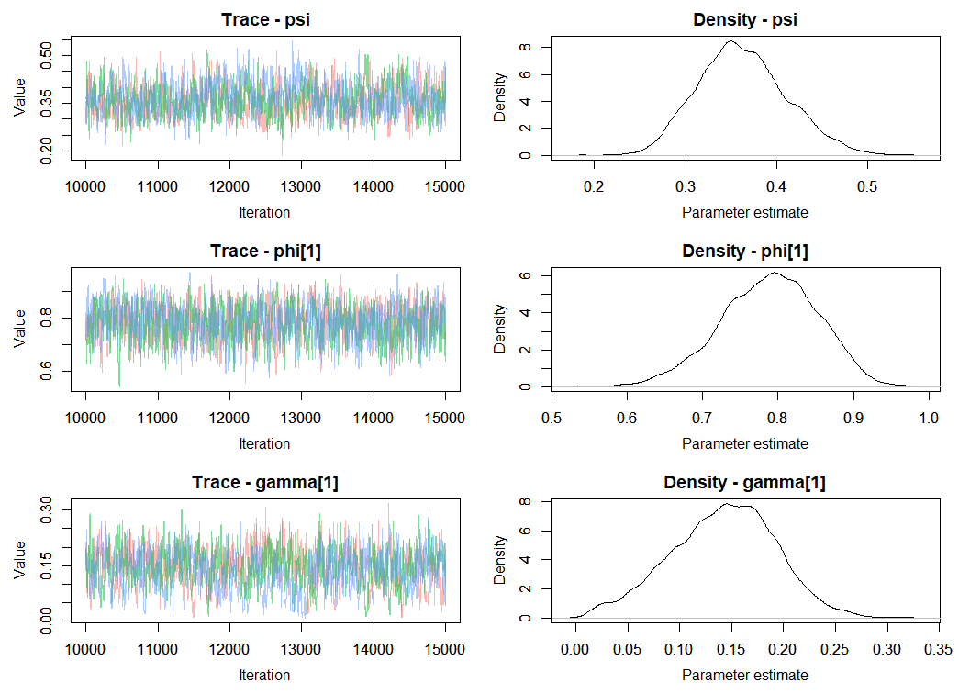
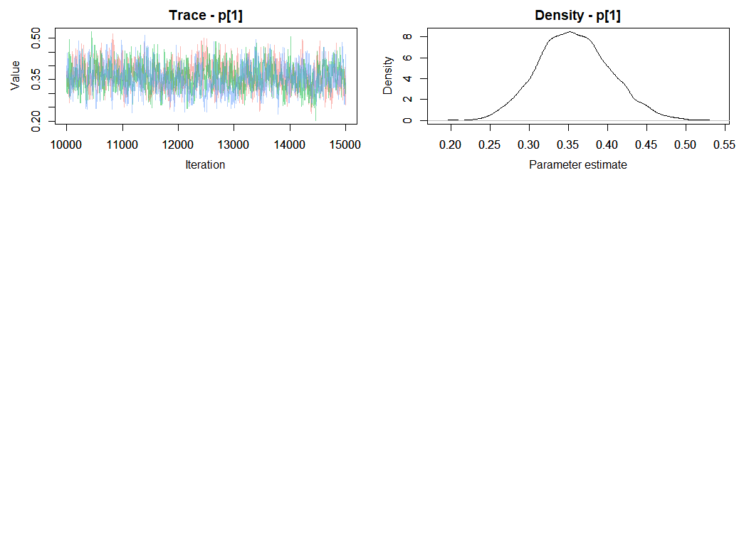
TracePlot
points start at: ramdom 0~1

Slide 23
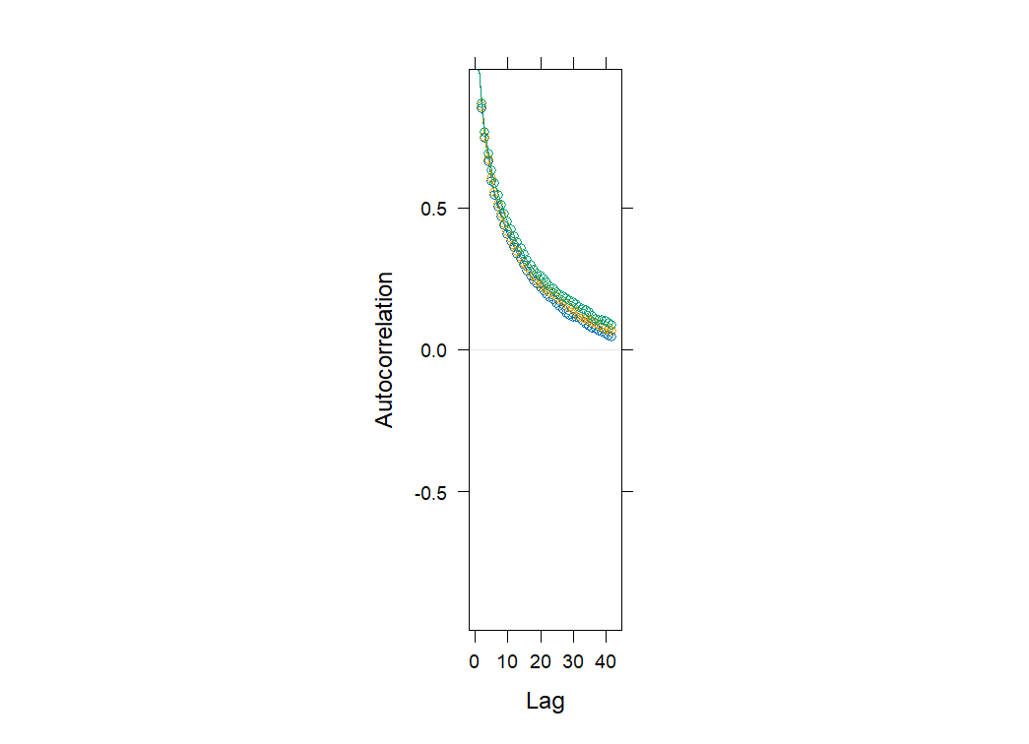
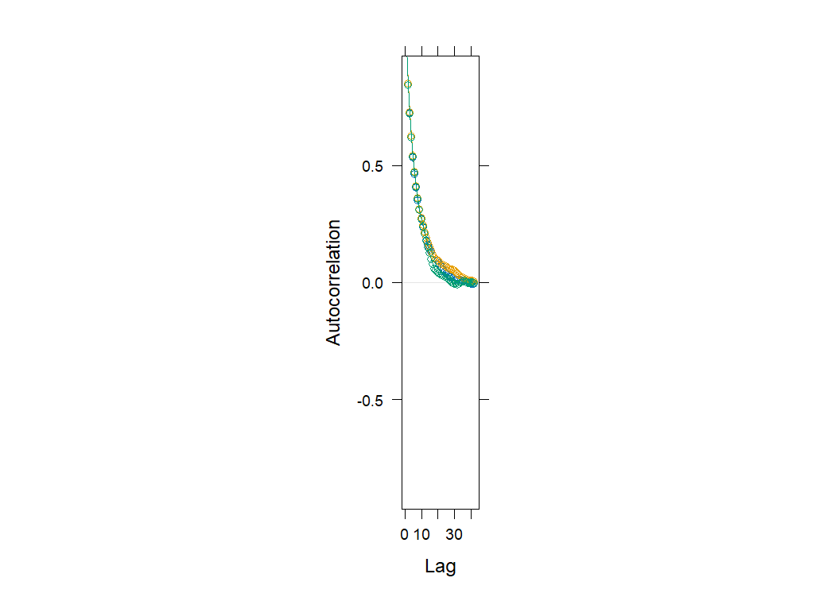
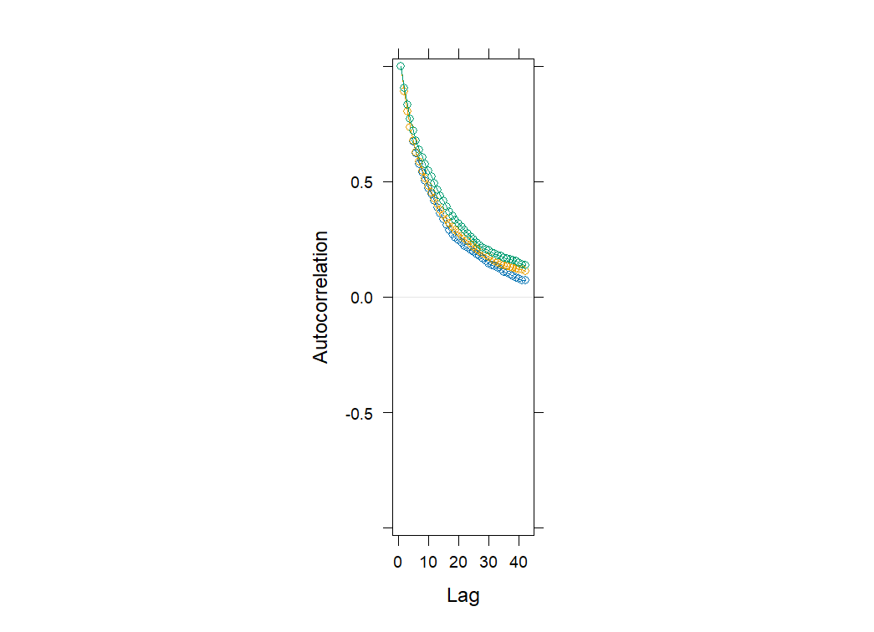
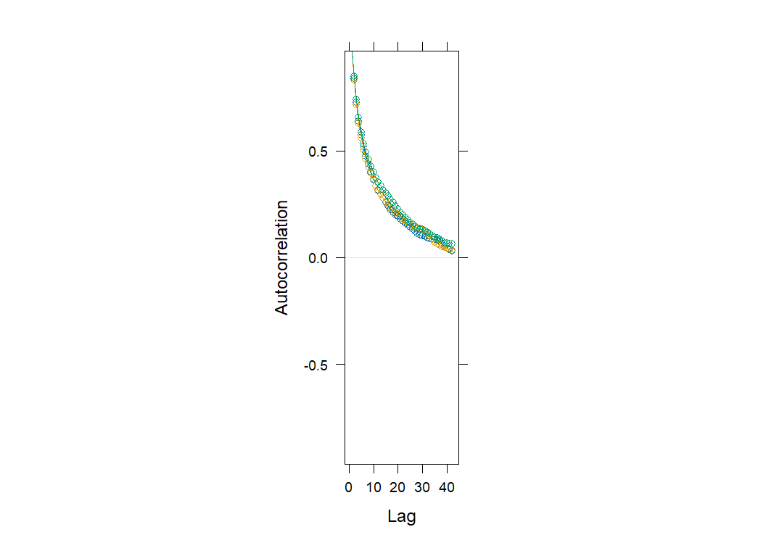
Acf plot
psi
phi[1]
gamma[1]
p[1]

Slide 24
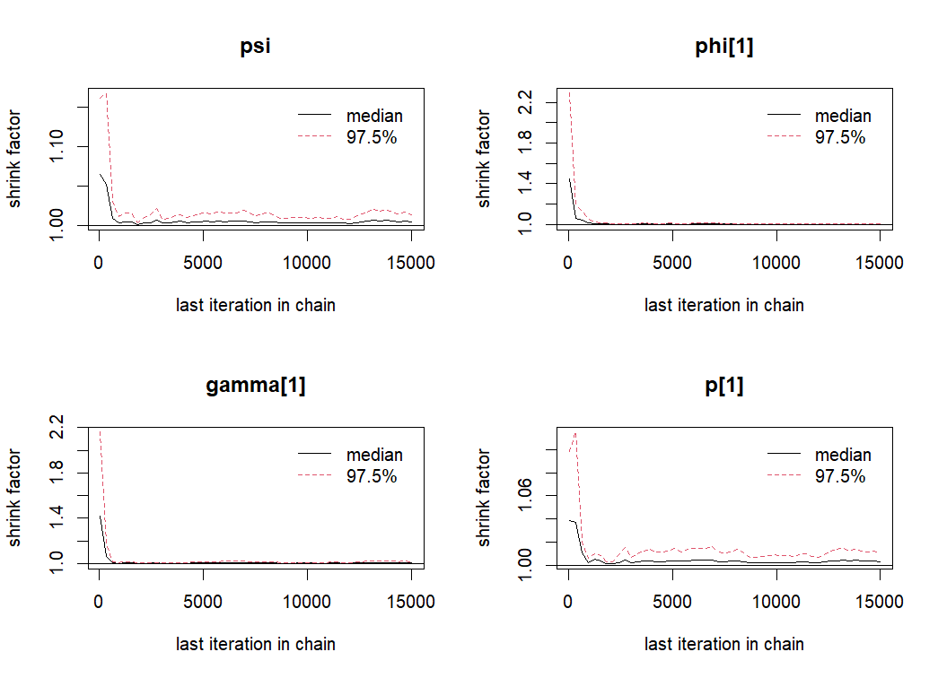
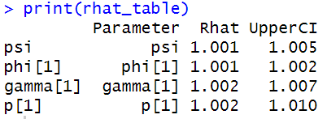
Gelman-Rubin

Slide 25
Informative Prior
The occupancy probability( ) and detection probability( ) should related to the environment (forest & elevation)
How can we make use of that? 🤔
💡 logit + Informative Prior

Slide 26
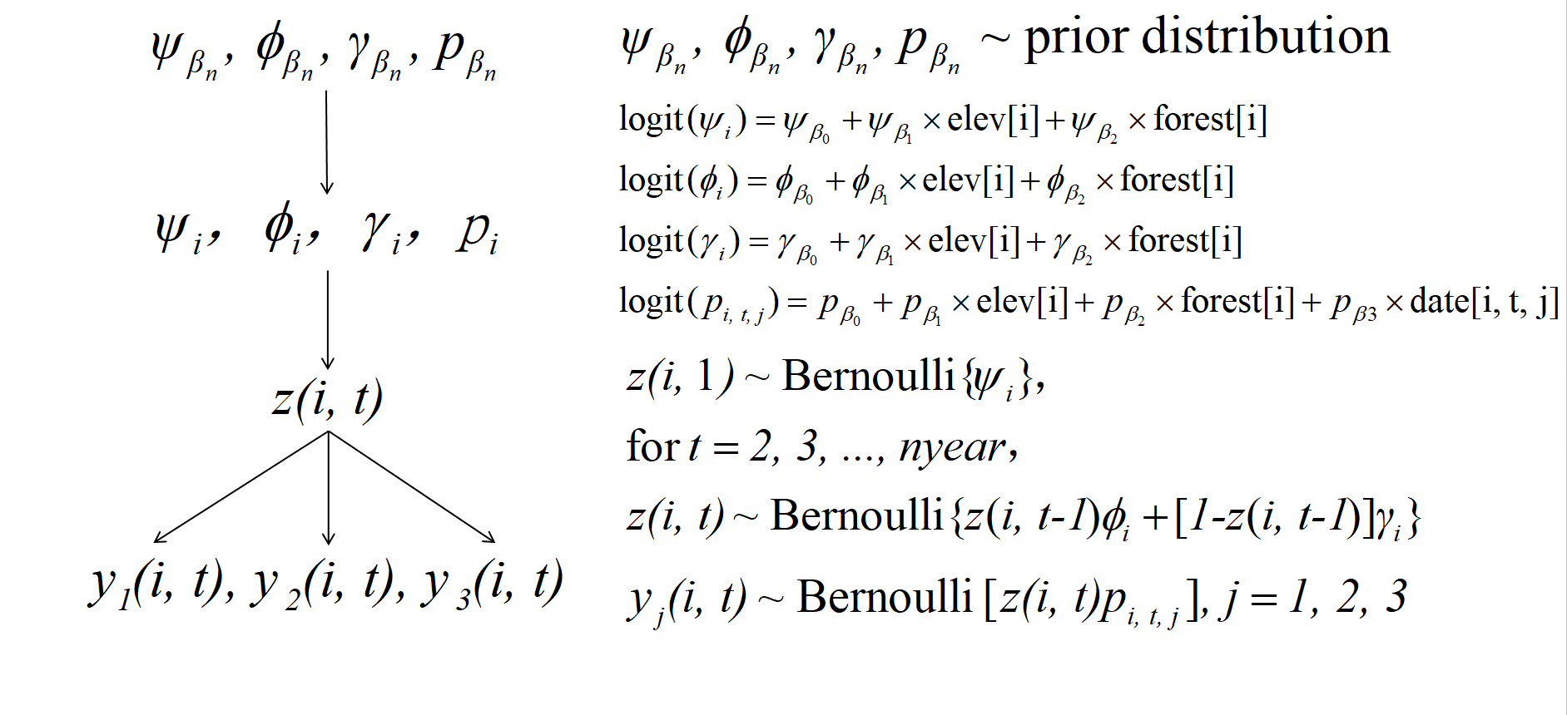
Model with Covariate

Slide 27
Model with Covariate
Notes:
这里的elev、forest和date标准化后的

Slide 28
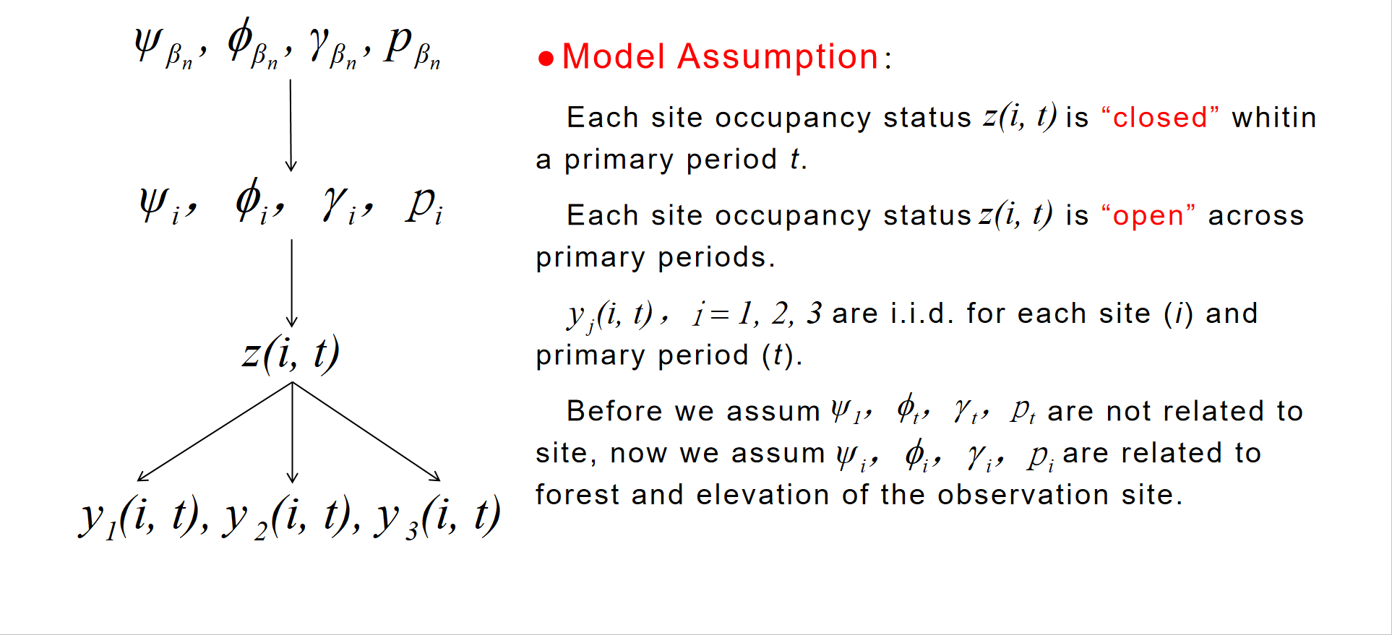
Model with Covariate
Model Assumption：
Each site occupancy status is “closed” whitin a primary period t.
Each site occupancy status is “open” across primary periods.
are i.i.d. for each site (i) and primary period (t).
Before we assum are not related to site, now we assum are related to forest and elevation of the observation site.

Slide 29
Model with Covariate
Model Assumption：
Each site occupancy status is “closed” whitin a primary period t.
Each site occupancy status is “open” across primary periods.
are i.i.d. for each site (i) and primary period (t).
Before we assum are not related to site, now we assum are related to forest and elevation of the observation site.

Slide 30
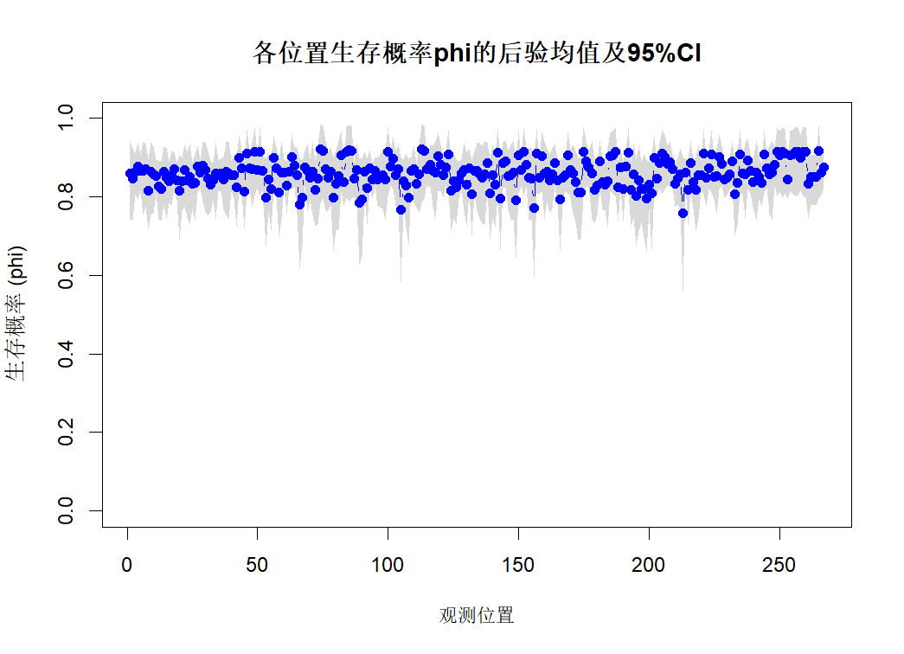
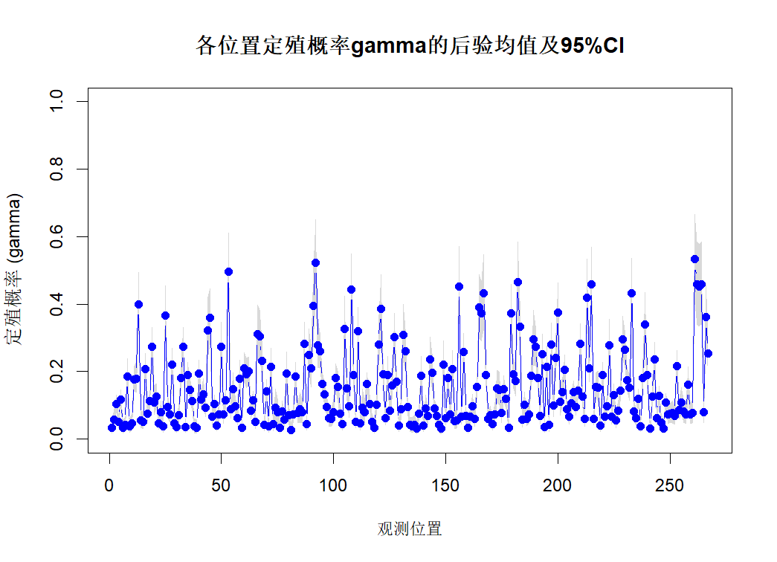
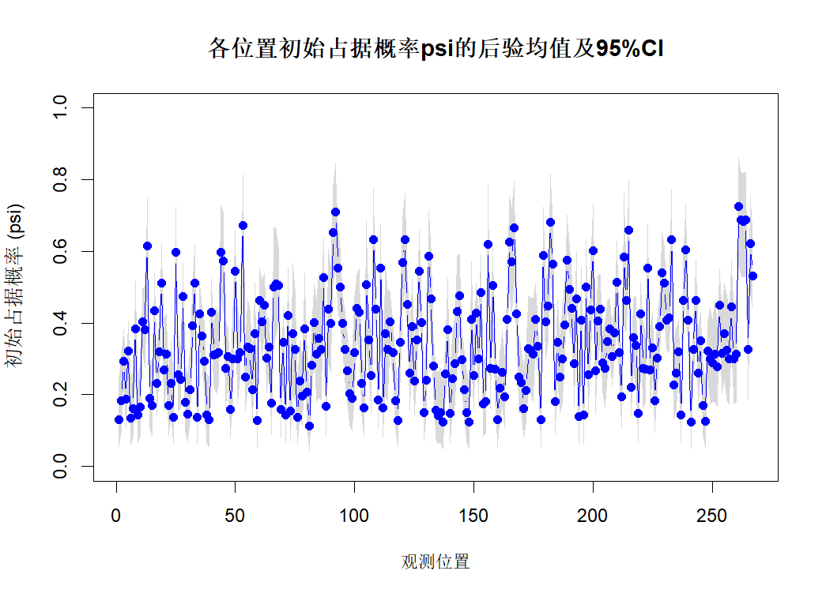
Model with Covariate
with Prior distribution:
Notes:
phi、gamma随年份波动小，psi随年份波动大，符合直觉

Slide 31
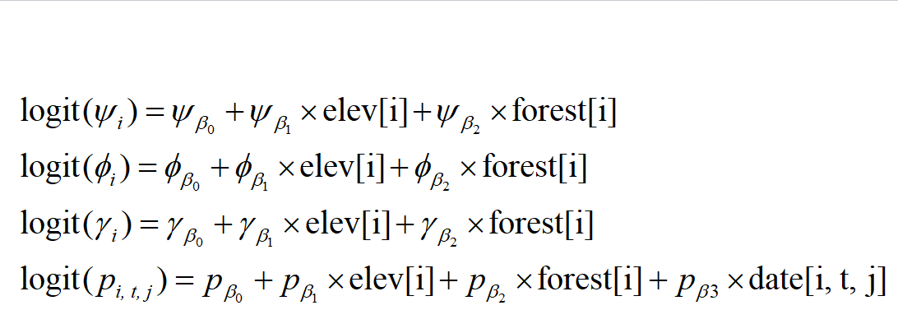


Model with Covariate
Notes:
phi、gamma随年份波动小，psi随年份波动大，符合直觉

Slide 32
MCMC——JAGS
Notes:
phi、gamma随年份波动小，psi随年份波动大，符合直觉

Slide 33




AcfPlot
phibeta1:
psibeta1:
gammabeta1:
delta1:
Notes:
phi、gamma随年份波动小，psi随年份波动大，符合直觉

Slide 34




TracePlot

Slide 35


Gelman-Rubin

